Slide 1
1.6.8.4 Multiplication of complex numbers

Slide 2
Introduction
In this topic, we will
Define the multiplication of complex numbers
Focus on the polar representation
Look at a geometric interpretation
Make some observations regarding properties
Prove multiplication distributes over addition

Slide 3
Review
Recall from secondary school the following two products:
You used the foil rule:
First
Outside
Inside
Last

Slide 4
Complex multiplication
Recall that , thus if
it follows that

Slide 5
Complex multiplication
Some examples:

Slide 6
Complex multiplication
Some more examples:

Slide 7
Polar representation
Problem: there is no reasonable geometric interpretation of complex multiplication using the rectangular representation…
Instead, we will have to go to the polar representation

Slide 8
Polar representation
Let and
Question: What is zw?
We only have the definition in rectangular representation, so

Slide 9
Polar representation
Recall your double-angle formulas:
Thus,

Slide 10
Polar representation
Thus,
Multiply the magnitudes and add the angles
Examples:
The value and
Given and ,
we have
which equals

Slide 11
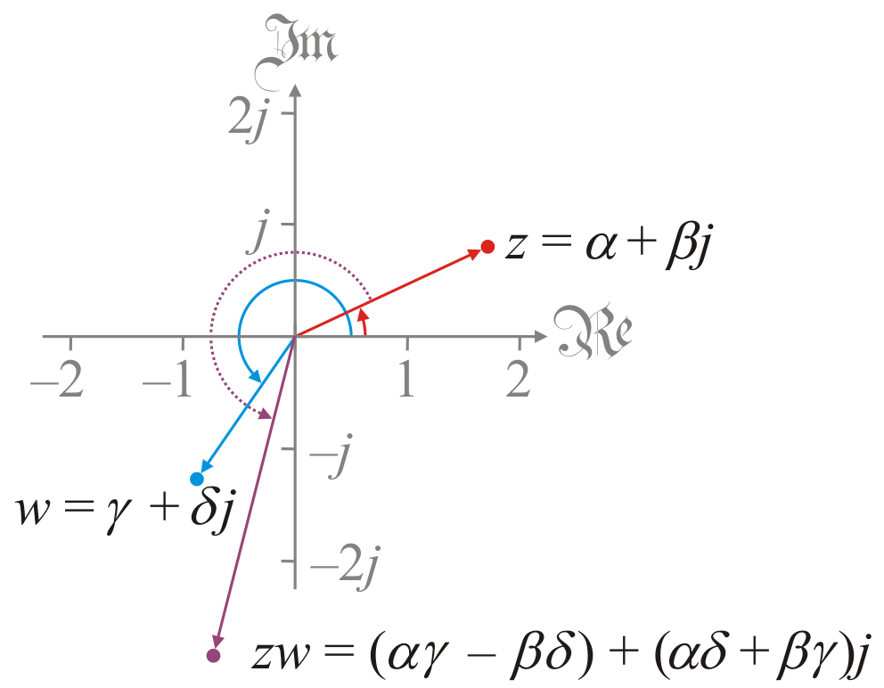
Geometric interpretation
If we have z and w, their product zw has:
The sum of the angles
The product of the absolute values

Slide 12
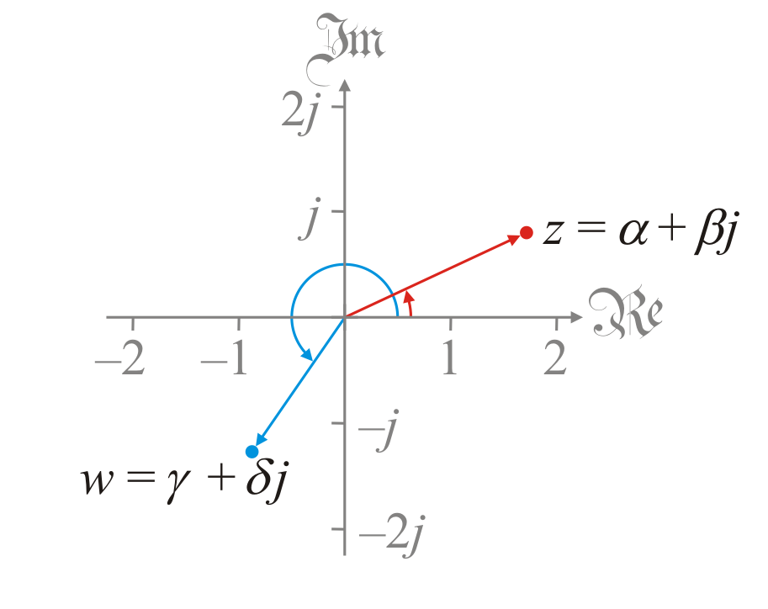
Geometric interpretation
Let’s consider a few products in particular
Here are z and w

Slide 13
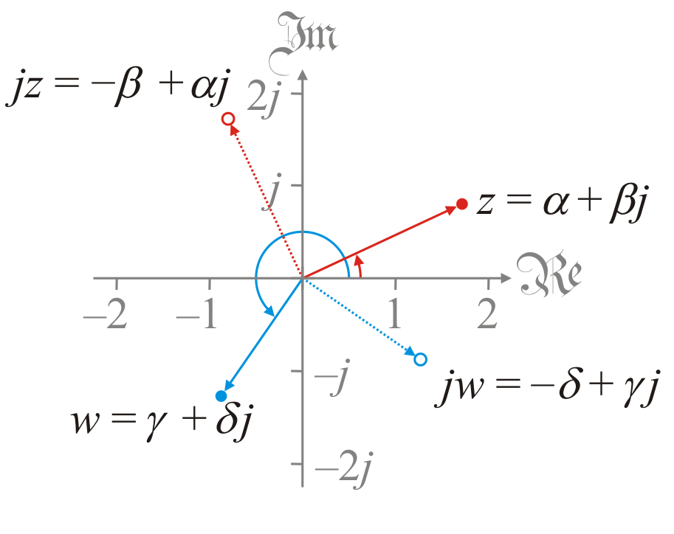
Geometric interpretation
Let’s consider a few products in particular
Recall that
Multiplying by j rotates complex numbers by 90° clockwise

Slide 14
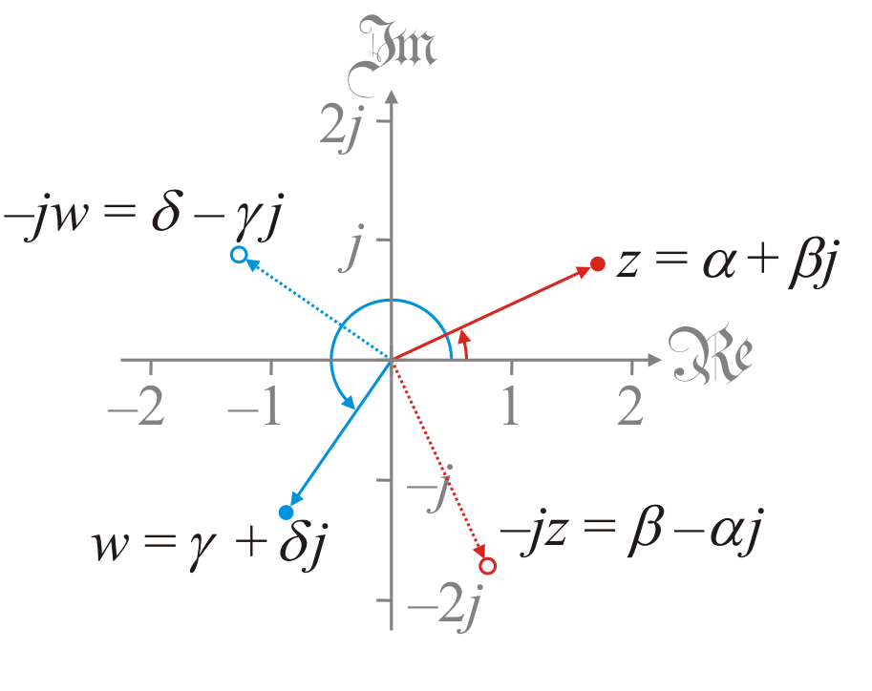
Geometric interpretation
Let’s consider a few products in particular
Recall that
Multiplying by –j rotates by 90° counter-clockwise

Slide 15
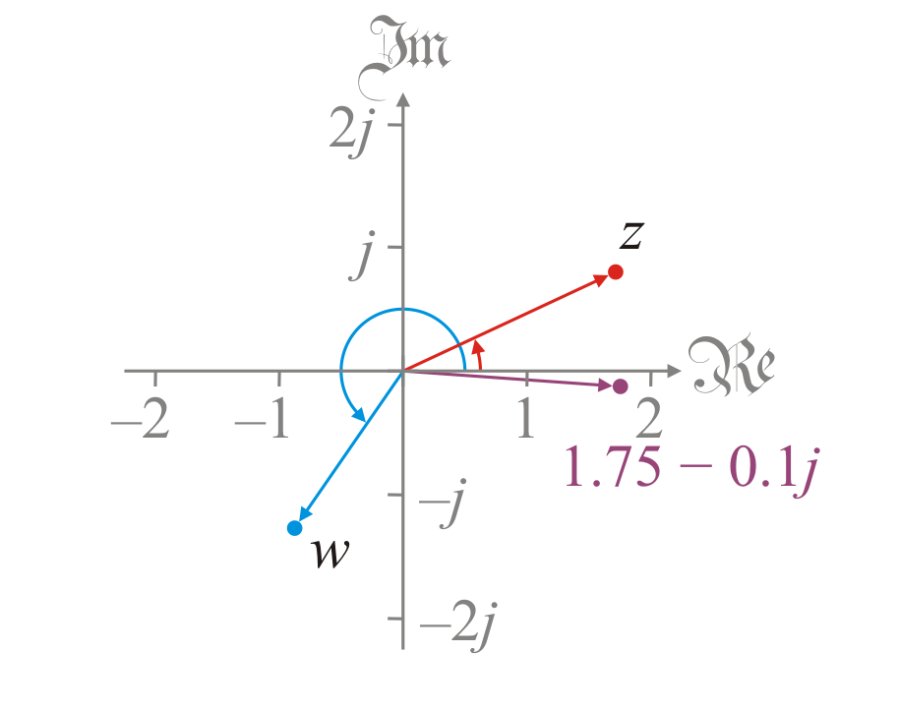
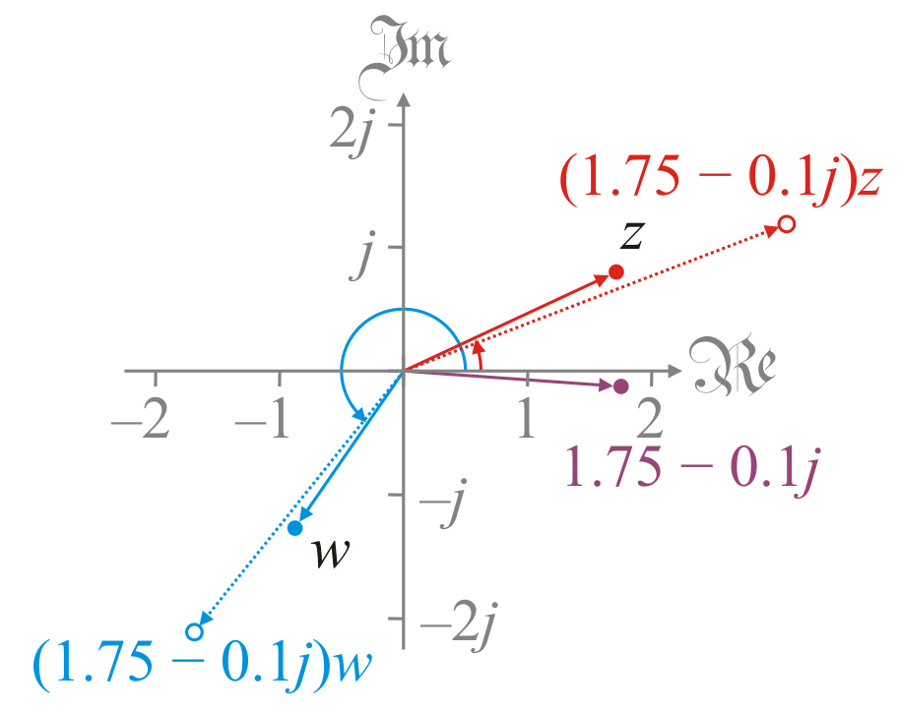
Geometric interpretation
Let’s consider a few products in particular
Suppose we are multiplying by 1.75 – 0.1j
This will stretch the numbers by a little more than 75%
It will rotate the numbers a few degrees counter-clockwise

Slide 16
Absolute value
Theorem: |zw| = |z||w|
The simple proof:
Recall that for and ,
the product is so |zw| = |z||w|.
QED

Slide 17
Absolute value
Theorem: |zw| = |z||w|
The tedious proof:
Taking the square root of both sides:
QED

Slide 18
Commutativity
Theorem: Complex multiplication is commutative.
The easy proof:
If and , then
But addition and multiplication of real numbers are commutative, so
QED

Slide 19
Commutativity
Theorem: Complex multiplication is commutative.
The tedious proof:
If and , then
But multiplication of real numbers is commutative, so
QED

Slide 20
Associativity
Theorem: Complex multiplication is associative.
The easy proof:
If , and , then
But addition and multiplication of real numbers are commutative, so
QED

Slide 21
Associativity
Theorem: Complex multiplication is associative.
The tedious proof:
If , and ,
QED

Slide 22
The multiplicative identity
Theorem: 1 is the multiplicative identity.
The easy proof:
If , then
The tedious proof:
If , then
QED
QED

Slide 23
Observations
Here are some more results from elementary school:
Multiplying two positive reals yields a positive real:
Multiplying two negative reals yields a positive real
Multiplying positive and negative real yields a negative real

Slide 24
Multiplication distributes over addition
Theorem: Complex multiplication distributes over addition.
Proof: If , and ,
But real multiplication distributes over real addition:
QED

Slide 25
Important takeaways
The most important takeaways are
Multiplying complex numbers in the rectangular representation is no more than multiplying two linear polynomials
In the polar representation, it is the product of the magnitudes and the sum of the angles
Given n complex numbers being multiplied, you can multiply them in any order, and you’ll get the same result
For example,
(3.9 + 5.7j)(1.8 – 8.6j)(–0.5 + 3.4j)(1.9 – 3.1j) (3.9 + 8.4j)(–6.4 + 1.5j)(2.2 + 4.2j)(4.1 – 7.0j)
equals –550769.08882032 – 1687878.63288576j

Slide 26
Summary
In this topic, we’ve introduced complex multiplication
Very similar to polynomial multiplication
The geometric interpretation is reasonably easy
We saw that
It is commutative
It is associative
1 + 0j is the multiplicative identity
Multiplication distributes over addition

Slide 27
References
[1] https://en.wikipedia.org/wiki/Complex_number#Addition_and_subtraction
[2] https://en.wikipedia.org/wiki/Absolute_value#Complex_numbers

Slide 28
Acknowledgments
Tina Hanna for correcting a typo.

Slide 29
Colophon
These slides were prepared using the Cambria typeface. Mathematical equations use Times New Roman, and source code is presented using Consolas.
The photographs of flowers and a monarch butter appearing on the title slide and accenting the top of each other slide were taken at the Royal Botanical Gardens in October of 2017 by Douglas Wilhelm Harder. Please see
https://www.rbg.ca/
for more information.

Slide 30
Disclaimer
These slides are provided for the ne 112 Linear algebra for nanotechnology engineering course taught at the University of Waterloo. The material in it reflects the authors’ best judgment in light of the information available to them at the time of preparation. Any reliance on these course slides by any party for any other purpose are the responsibility of such parties. The authors accept no responsibility for damages, if any, suffered by any party as a result of decisions made or actions based on these course slides for any other purpose than that for which it was intended.

